Slide 1




IEEE ICNP 2025, Sep 22-25,
Seoul, South Korea
SlideLoRa: Reliable Channel Activity Monitoring across Massive Logical Channels in LoRa Networks
Jiamin JIANG¹, Shiming YU², Hao WANG³, Haiyang LI⁴, Yuanqing ZHENG², Lu WANG⁴
¹Nankai University, Tianjin, China
²The Hong Kong Polytechnic University, Hong Kong, China
³Wuhan University, Wuhan, China
⁴Shenzhen University, Shenzhen, China
Notes:
Good morning everyone. My name is Haiyang Li from Shenzhen University.
Today I’m excited to present our work, SlideLoRa: Reliable Channel Activity Monitoring across Massive Logical Channels in LoRa Networks. This is a collaboration with students and teachers from Nankai University, The Hong Kong Polytechnic University, Wuhan University, and Shenzhen University.
We’re presenting at IEEE ICNP 2025 in Seoul. Thank you for being here.

Slide 2




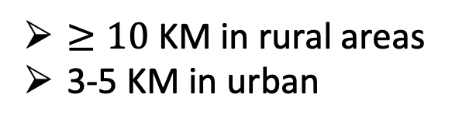
Low Power Wide Area Network
(Long Range)
$≥10$ KM in rural areas
3-5 KM in urban
Low Power
AA battery for 10+ years
High Sensitivity
Below-noise reception
(down to -148dBm)
Notes:
Let me start with a quick refresher on LoRa. LoRa is a Low-Power Wide-Area technology—lora end nodes can run for 10+ years on AA batteries, and gateways can receive below-noise signals, thanks to the high sensitivity of Chirp Spread Spectrum. This combination—ultra-low power and long range—makes LoRa being a foundational technology for massive IoT deployments.

Slide 3
Low Power Wide Area Network
(Long Range)
$≥10$ KM in rural areas
3-5 KM in urban
Goal: connect 1,000+ of LoRa nodes per gateway
under poor channel conditions
Low Power
AA battery for 10+ years
High Sensitivity
Below-noise reception
(down to -148dBm)
Notes:
Our goal is: connect over 1,000 LoRa nodes per gateway under poor channel conditions—
think city-scale sensing or harsh outdoor environments where reliability really matters. That scalability target drives this paper you’ll see today.

Slide 4
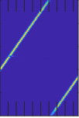
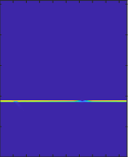
LoRa PHY Background
Frequency
Frequency
Amp
FFT
Initial
Frequency
“Peaks”
Base DownChirp
max (FFT bin)
Time
Time
FFT bin
Bin #40
LoRa uses CSS modulation:
LoRa Parameters:
The initial frequency of each symbol represent the modulation data.
Spread Factor(SF): 6-12
Bandwidth(BW): 62.5/125/250/500kHz
Notes:
A bit of PHY background to set the stage.
LoRa uses Chirp Spread Spectrum. Each symbol’s initial frequency encodes data. Two LoRa parameters matter a lot for us: Spread Factor (SF 6 to 12) and Bandwidth (BW 62.5 and 125 and 250 and 500 kHz).

Slide 5
Logical Channels in LoRaWAN
<Central Frequency, Spread Factor, Bandwidth> ➔ Logical Channel
e.g. Packet #1 (SF7, BW125kHz), #2 (SF9, BW250kHz), #3 (SF11, BW500kHz)
Even more packets(with different logical channels) can be transmitted simultaneously within 500kHz bandwidth.
LoRaWAN provides diverse and flexible Logical Channels for massive IoT nodes.
Notes:
In LoRaWAN, a logical channel is defined by the triple 〈center frequency, Spread Factor, Bandwidth〉.
In the design of LoRa, it actually provides diverse and flexible channel configurations to support massive IoT communications.
different bandwidth and central frequency to occupy a narrow-band physical channel in the spectrum.
As you can see in the figure, we show an example where three different logical channel packets can be transmitted simultaneously within 500kHz bandwidth.

Slide 6
Logical Channels in LoRaWAN
LoRa works in unlicensed ISM band (e.g., US902-928, BW 125kHz, SF6-12).
Physical Channel: 26MHz / 125kHz = 208
Logical Channel: 208 $×$ 7 = 1,456
Thousands of logical Channels can be used for concurrent transmissions.
Notes:
Because different Spread Factors can coexist on the same frequency—and multiple bandwidths can partition the spectrum—thousands of logical channels are available for concurrent transmissions in ISM bands.
Take US902 to 928 as an example, the ISM band has a 26MHz spectrum.
If we use BW 125kHz, we can get more than 200 physical channels.
Using all spread factors, we can get thousands of logical channels.
Considering more BW settings, this number could be even larger.
That’s a huge concurrency opportunity, but it also makes cross-channel activity monitoring extremely challenging.

Slide 7

Motivation(Previous Works)
Many works have explored concurrent packet detection across different logical channels.
Correlation-Based Methods:
(e.g. LoRadar, INFOCOM’22)
Dechirp-Based Methods:
(e.g. XGate, Mobicom’24)
Frequency
Frequency
Time
Time
Base Up-Chirp
demodulation window
Limitation: Scalability
Limitation: Fail under low SNR
Notes:
Many prior works attempt concurrent packet detection across logical channels. Roughly, there are two families:
Correlation-based (such as LoRadar, accepted by INFOCOM 2022 ): good idea, but scalability is the bottleneck.
Dechirp-based (such as XGate, accepted by MobiCom 2024): efficient, but tends to fail under low SNR.

Slide 8
Motivation(Previous Works)
Many works have explored concurrent packet detection across different logical channels.
Correlation-Based Methods:
(e.g. LoRadar, INFOCOM’22)
Dechirp-Based Methods:
(e.g. XGate, Mobicom’24)
SlideLoRa: Is it possible to efficiently and reliably monitor the channel activity across massive logical channels even under poor channel conditions
Frequency
Frequency
Time
Time
Limitation: Scalability
Limitation: Fail under low SNR
Notes:
So the open question is:
Is it possible XXX
This is the core design target of SlideLoRa.

Slide 9
Design Overview
Expanding the demodulation window during the packet detection process
Fine-grained sliding inside each window
Three robustness algorithms for recovering frequency domain features
Notes:
Before going into the method details, let’s first look at the high-level workflows of SlideLoRa
we start with unknown packets in the wireless channel.
SlideLoRa uses an expanded demodulation window during packet detection and slides this window at a fine-grained level for dechirp.
During the packet detection, SlideLoRa do symbol peak tracking, peak-sequence matching, LoRa parameter extraction, window alignment and frequency evaluation.
In order to ensure that the frequency domain features can still be recovered in the case of poor channel condition, we also design three robust algorithms for SlideLoRa
Finally, the packet detailed parameters are then passed to a standard LoRa demodulator and decoder to recover the payload data.

Slide 10
Design
Problem: Energy leakage occurs when the window doesn’t fully cover a chirp, and efficiency is low because different logical channels require multiple scan rounds across SF/BW combinations.
Frequency
:SF9, BW250kHZ
Signal strength
From Up-chirp
<SF9, BW250kHz>
Up-chirp
Time
FFT bin
Energy Leakage!
Note: Even though many works attempt to recover these energy leakage, cross-channel interference and near-far effect still prevent full energy recovery.
Notes:
Conventional dechirp-based method use a short, fixed demodulation window.
and move the entire length of the window at once [连续点击 4 次鼠标]
This causes two practical issues:
Firstly, energy leakage when the window doesn’t fully cover a chirp—the peak is split into 2 parts, detection becomes unstable. [点击 1 次鼠标]
Secondly, low efficiency. because different logical channels require multiple scan rounds across SF and BW combinations.

Slide 11
Design
Solution #1: For each chirp slope, SlideLoRa uses the maximum-duration demodulation window.
Frequency
:SF9, BW250kHZ
:SF11, BW500kHZ
Signal strength
From first Up-chirp
<SF9, BW250kHz>
From second Up-chirp
<SF11, BW500kHz>
First Up-chirp
Time
FFT bin
Second Up-chirp
Note: With the extended window, small-SF chirps are fully covered with their energy concentrated into a stable FFT bin, while packets sharing the same chirp slope can be detected simultaneously, enabling scalability to thousands of logical channels.
Notes:
Our first idea is simple but powerful: For each chirp slope, SlideLoRa extends the demodulation window to the maximum chirp duration—for example, SF11.
This ensures small-SF chirps are always fully covered; their energy concentrated into a stable single FFT bin—no leakage.
At the same time, packets sharing the same chirp slope can be detected simultaneously, enabling scalability to thousands of logical channels

Slide 12
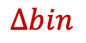
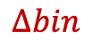
Design
Solution #2: SlideLoRa uses fine-grained sliding demodulation window.
first symbol
It move with fixed
offset
Frequency
Signal strength
first symbol
Frequency
Signal strength
Move with fixed offset
second symbol
$$∆bin$$
$$∆bin$$
Time
FFT bin
Sliding with fine-grained!
Time
FFT bin
Step #1
Step #2
Note: When the demodulation window slides forward by a small step, the FFT peak of the same symbol shifts by a fixed bin offset determined by the step-to-window ratio.
Notes:
But extended demodulation windows alone are not enough at low SNR or under near-far effect.
So our second idea is to apply a fine-grained sliding demodulation window. [点击鼠标，出发动画]
As we slide by a smaller step, we capture richer frequency-domain feature;
Please note that as the window slides, the peak in the frequency domain will shift by a fixed offset, which is also a frequency-domain feature

Slide 13
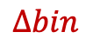
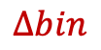

Design
Signal strength
first symbol
second symbol
first symbol
first symbol
second
symbol
second
symbol
$$∆bin$$
FFT bin
FFT bin
FFT bin
Sliding with
more fine-grained!
Step #1
Step #2
Signal strength
first symbol
first symbol
second symbol
second
symbol
$$∆bin$$
$$∆bin$$
Step #
SlideLoRa: Symbol Peak Tracking
FFT bin
Step #4
FFT bin
Step #3
Note: With continuous fine-grained sliding, FFT peaks of the same chirp move with a fixed offset, forming a clear trajectory. SlideLoRa tracks these trajectories across steps to recover symbol features under low SNR.
Notes:
OK, let’s stack several consecutive demodulation windows—step 1 to 4.
You can observe that for the first symbol, its peak keeps a fixed bin offset in the frequency domain and drifts in one direction across windows.
For the second symbol, the same rule holds, and its energy gradually increases.
Now look at the result with more fine-grained sliding, right figure. The x-axis is the step index, the y-axis is the FFT bin in the frequency domain, and the z-axis is the Signal strength.
We see a clear pattern for symbols from the same packet: energy ramps up, the peak shifts by a constant bin increment in a fixed direction, and peaks for consecutive symbols are equally spaced.
SlideLoRa leverages exactly this regularity to detect a packet.

Slide 14
Design
Problem: When packets with different SF/BW coexist (cross-channel interference), their symbols overlap, making it difficult to separate symbols.
Frequency
:SF9, BW250kHZ
:SF11, BW500kHz
Signal strength
symbol #1 <SF9, BW250kHz>
symbol #1 <SF11, BW500kHz>
symbol #2 <SF9, BW250kHz>
Time
FFT bin
Notes:
The second problem is that
when packets with different Spread Factors and bandwidths are transmitted simultaneously in the same frequency band, called cross-channel interference, their symbols overlap, making it difficult to distinguish them in the frequency domain.

Slide 15
Design
Solution: SlideLoRa leverages the fact that packets from different logical channels produce distinct peak-tracking trajectories, enabling separation and recovery even under cross-channel interference.
Signal strength
symbol #1
<SF11, BW500kHz>
symbol #1
<SF9, BW250kHz>
symbol #1
<SF9, BW250kHz>
FFT bin
Step #
symbol #1
<SF11, BW500kHz>
Step #
Note: Since SF/BW configurations determine symbol duration, their peak sequences follow different slopes and lengths across sliding windows.
Notes:
Our key insight is that packets from different logical channels generate distinct peak-tracking trajectories, which allows SlideLoRa to easily separate them across consecutive demodulation windows.
As shown in the figure, the blue symbols come from one LoRa packet (SF9, BW 250 kHz), while the red symbols come from another packet (SF11, BW 500 kHz).
On the projection plane of the x-axis (step index) and z-axis (Signal strength), they exhibit clearly different patterns—such as different slopes and the number of peaks.
SlideLoRa exploits these differences in peak-tracking trajectories to separate different packets.

Slide 16
Design
Problem: Under the near-far effect, weak-symbol peaks will be distorted, making peak matching unstable and frequency domain features unreliable.
Solution #1: SlideLoRa leverages peak regression to interpolate and recover the missing weak peaks, ensuring the continuity of peak sequences for robust symbol tracking.
Notes:
The last problem is under near–far effect: the weak symbol peaks will be distorted, so the frequency domain features unreliable
SlideLoRa uses 3 algorithms for recovering frequency domain features.
Our Solution #1 is Peak Regression.
We look across consecutive sliding windows, fit the expected trajectory, and interpolate the missing weak peaks. This restores the continuity of the peak sequence, which makes symbol tracking and packet detection stable even when a strong neighbor masks a weak one.
PS：这里受益于细粒度地窗口滑动，需要简单的线性回归就可以拟合出峰值轨迹。
PS:: Here it benefits from fine-grained window sliding, requiring a simple linear regression to fit the peak trajectory.

Slide 17
Design
Problem: Under the near-far effect, weak-symbol peaks may disappear, making peak matching unstable and frequency domain features unreliable.
Solution #2: SlideLoRa adjusts constraints by signal strength: strict for strong symbols, loose for weak ones, ensuring robust tracking.
Solution #3: SlideLoRa iteratively extracts peaks with a dynamic threshold.
Notes:
Solution #2 is Adaptive Constraints. We adjust matching strictness by signal strength: strict tolerance for strong peaks, looser for weak peaks. This prevents fragile sequences from breaking at low SNR.
Solution #3 is Dynamic Threshold and Iterative Extraction. We Iteratively extract peaks with a dynamic threshold.

Slide 18
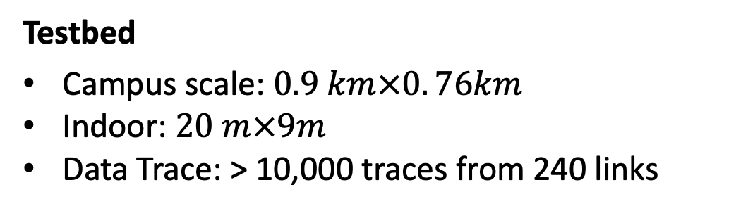
Evaluation
Implementation
Software implementation at gateways
SDR gateway: USRP N210
COTS LoRa nodes: Semtech SX1272
Testbed
Campus scale: $0.9 km×0. 76km$
Indoor: $20 m×9m$
Data Trace: > 10,000 traces from 240 links
Notes:
OK, Let’s move on to the evaluation part.
We implemented a prototype on a SDR platform, and performed comprehensive experiments to evaluate SlideLoRa.
We conducted experiments on a campus representing a typical urban environment and in an office area representing an indoor environment.

Slide 19
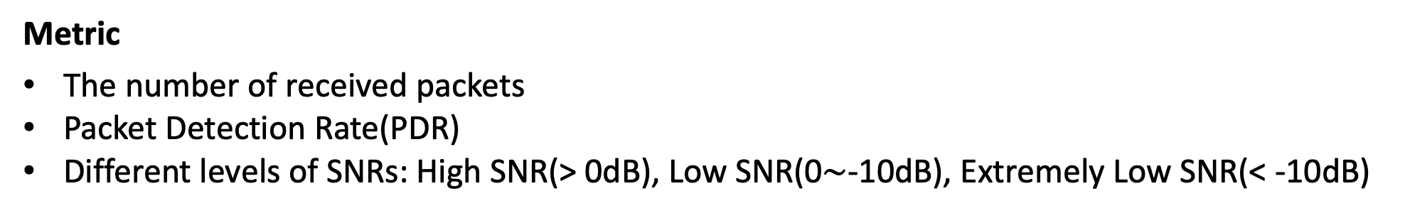
Evaluation
Benchmark
LoRaWAN: CAD on pre-configured channels
MALoRa: multi-antenna to improve sensitivity
LoRadar: cross-channel detection
XGate: wideband dechirp
SlideLoRa settings
Spectrum: 914-916MHz frequency band
BW: 62.5/125/250/500 kHZ
SF: 6-12
Nodes number: 20
Metric
The number of received packets
Packet Detection Rate(PDR)
Different levels of SNRs: High SNR(> 0dB), Low SNR(0$\sim$-10dB), Extremely Low SNR(< -10dB)
Notes:
We compare SlideLoRa against four baselines representing common practices: LoRaWAN, MALoRa, LoRadar and Xgate.
We deploy 20 nodes outdoors in the 914 to 916 MHz band, permitting BW 62.5–500 kHz and SF 6–12.
To emulate large concurrency, a trigger node broadcasts, then nodes randomly pick among 240 logical channels and transmit. This lets us stress-test scalability and robustness.

Slide 20
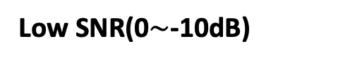
Evaluation: Different SNRs
High SNR(> 0dB)
Low SNR(0$\sim$-10dB)
Extremely Low SNR(< -10dB)
SNR=10 dB: SlideLoRa = 136 vs LoRadar=24, XGate=112 → 5.7× / 1.2× gain
SNR=0 dB: SlideLoRa = 104 vs LoRadar=10, XGate=78 → 10.4× / 1.3× gain
SNR=-10 dB: SlideLoRa = 82 vs LoRadar=8, XGate=48 → 10.3× / 1.7× gain
Notes:
Next, let’s look at the evaluation under different SNR conditions.
At SNR equals 10 dB, SlideLoRa receives 136 packets, which is 5.7 times higher than LoRadar and 1.2 times higher than XGate.
At SNR equals 0 dB, SlideLoRa still receives over 100 packets, while LoRadar only sees 10 and XGate 78. That’s 10 times and 1.3 times improvements.
Even at -10 dB, where small Spread Factor packets become undecodable due to LoRa’s limits, SlideLoRa receives 82 packets, far more than LoRadar and XGate .
In summary, SlideLoRa remains robust across all SNR levels, consistently receiving more packets than prior approaches.

Slide 21
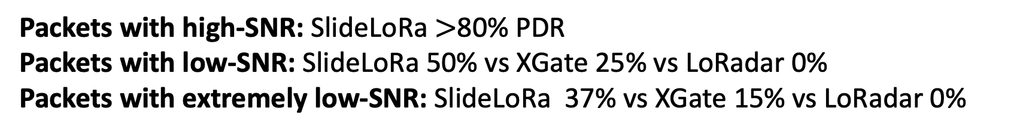
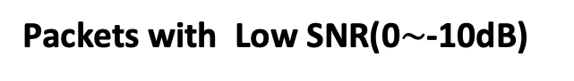
Evaluation: Near-far effect
Packets with High SNR(> 0dB)
Packets with Low SNR(0$\sim$-10dB)
Packets with Extremely Low SNR(< -10dB)
Packets with high-SNR: SlideLoRa $>$80% PDR
Packets with low-SNR: SlideLoRa 50% vs XGate 25% vs LoRadar 0%
Packets with extremely low-SNR: SlideLoRa 37% vs XGate 15% vs LoRadar 0%
Notes:
Next, we evaluated SlideLoRa under near-far effect, where packets have different SNRs due to distance and environment.
We divided packets into 3 groups: high-SNR ($>$0 dB), low-SNR ($−10$ to 0 dB), and extremely low-SNR ($<−10$ dB).
Each group has 90 packets, totally 270.
The PDR of high-SNR packets decreases with more concurrency, but SlideLoRa still maintains over 80% PDR even with 90 high-SNR packets.
For the more challenging groups, SlideLoRa shows a clear advantage. With 270 packets, it achieves 50% PDR for low-SNR and 37% for extremely low-SNR packets, while XGate only reaches 25% and 15%, and LoRadar fails entirely.
The reason is SlideLoRa’s fine-grained sliding window and peak-tracking design, which allow it to separate packets of different energy levels much more effectively than the baselines.

Slide 22
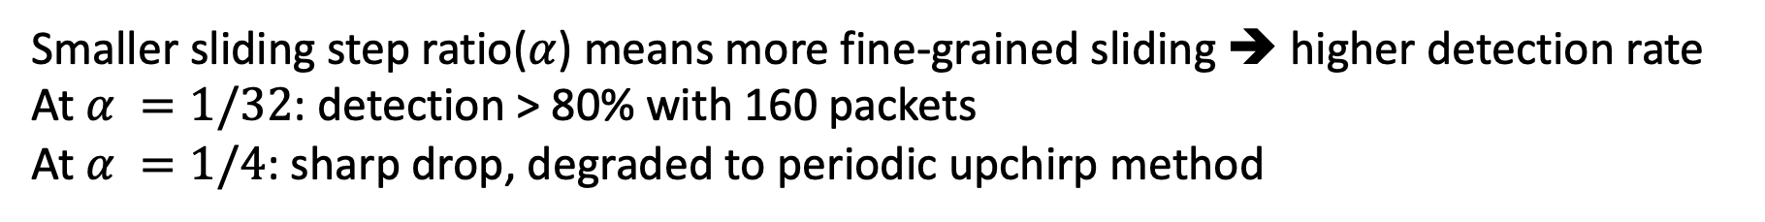
Evaluation: Different ratio of sliding step size
Smaller sliding step ratio($α$) means more fine-grained sliding ➔ higher detection rate
At $α =1/32$: detection > 80% with 160 packets
At $α =1/4$: sharp drop, degraded to periodic upchirp method
Notes:
We further evaluated how the sliding step ratio, denoted as $α$(alpha), affects packet detection.
A smaller $α$, means more fine-grained sliding. In our experiment with more than 180 concurrent packets, we varied$α$(alpha), from 1/4 to 1/32.
The results are clear: when $α$(alpha) is reduced to 1/32, detection remains above 80% even with 160 concurrent packets.
In contrast, when $α$(alpha) is as large as 1/4, performance drops sharply, essentially degrading to conventional LoRa’s periodic upchirp detection.
This shows that fine-grained sliding is critical for maintaining high detection accuracy in high-concurrency scenarios.

Slide 23
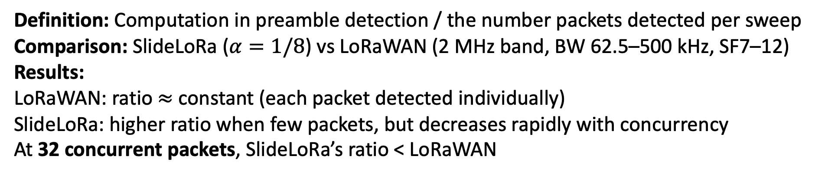
Evaluation: Overhead
Definition: Computation in preamble detection / the number packets detected per sweep
Comparison: SlideLoRa ($α=1/8$) vs LoRaWAN (2 MHz band, BW 62.5–500 kHz, SF7–12)
Results:
LoRaWAN: ratio $≈$ constant (each packet detected individually)
SlideLoRa: higher ratio when few packets, but decreases rapidly with concurrency
At 32 concurrent packets, SlideLoRa’s ratio < LoRaWAN
Notes:
Finally, we evaluate overhead by defining the detection computation ratio, which is the computation in preamble detection divided by the number of packets detected per sweep.
In LoRaWAN, every packet requires its own detection, so the ratio stays nearly constant regardless of concurrency.
SlideLoRa, on the other hand, does one more expensive detection per slope group. This initially gives it a higher ratio when only a few packets exist.
But as concurrency increases, the cost is shared across many packets, so the ratio drops quickly.
Importantly, once SlideLoRa reach about 32 concurrent packets, SlideLoRa’s per-packet computation ratio becomes lower than LoRaWAN’s, making it more efficient under realistic, high-concurrency conditions.

Slide 24
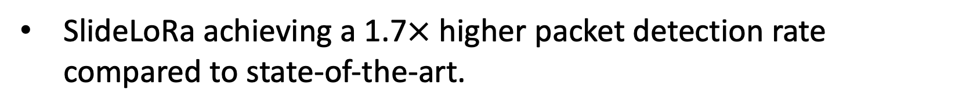
Conclusion
SlideLoRa is the first system capable of efficiently and reliably monitoring all logical channel activities in a LoRa network under poor channel conditions and without prior knowledge of incoming packets.
Introduce a novel peak feature recovery technique that leverages the impact of window offset on detection results to extract signal features of individual LoRa symbols.
SlideLoRa achieving a 1.7$×$ higher packet detection rate compared to state-of-the-art.
Notes:
To summarize:
SlideLoRa is, to our knowledge, the first system that can efficiently and reliably monitor all logical-channel activities in a LoRa network under poor channel conditions—and it works without any prior knowledge of the incoming packets.
We introduced a novel peak feature XXX
In evaluation, SlideLoRa achieves a 1.7× higher packet-detection rate compared with state-of-the-art systems.

Slide 25
Thank you!
Q&A
If you are interested in more technical details,
please feel free to contact the author Jiamin JIANG!😊
Email: jiangjiamin@mail.nankai.edu.cn
Notes:
Thank you for listening. I’m happy to take questions.

Slide 26
Motivation
Conventional dechirp-based method: uses a short, fixed window.
Limitation #1: Energy Leakage
Frequency
:SF7, BW125kHZ
:SF9, BW250kHz
When symbol duration does not align with the window: Part of the chirp falls outside
Limitation #2: Low efficiency
Each logical channel has a different SF/BW configuration, and multiple rounds of detection are required for different configurations.
Time

Slide 27
Motivation
SlideLoRa: Extend the demodulation window to the maximum chirp duration (e.g., SF12).
Advantage #1: Complete Energy Aggregation (No Leakage)
Frequency
:SF7, BW125kHZ
:SF9, BW250kHz
With an extended window, a small-SF chirp is always fully covered, and all symbol energy is aggregated into a single FFT bin.
Advantage #2: Efficient Multi-channel Detection
Time
The extended window can simultaneously detect all packets with the same chirp slope, enabling scalability to thousands of logical channels.

